Slide 1
Final Engagement
Attack, Defense & Analysis of a Vulnerable Network

Slide 2
Table of Contents
This document contains the following resources:
Network Topology & Critical Vulnerabilities
Exploits Used
Methods Used to Avoiding Detect

Slide 3

Network Topology
& Critical Vulnerabilities
3

Slide 4
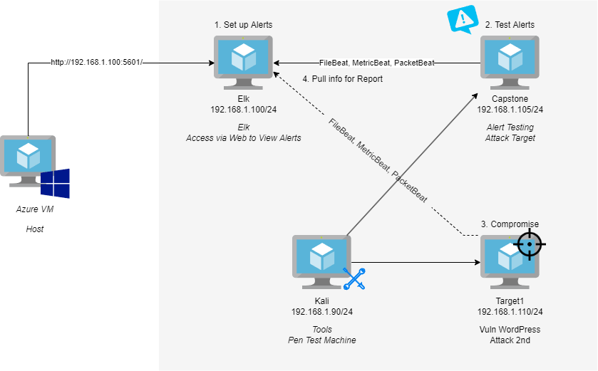
Network Topology
SS
Network
Address Range:192.168.1.0/24
Netmask: 255.255.255.255
Gateway: 192.168.1.1
Machines
IPv4: 192.168.1.100
OS: Ubuntu
Hostname: ELK
IPv4:192.168.1.90
OS: Debian Kali
Hostname: Kali
IPv4: 192.168.1.105
OS: Ubuntu
Hostname: Capstone
IPv4: 192.168.1.110
OS:Debian GNU / Linux 8
Hostname: Target 1
H
Y
P
E
R
-
V

Slide 5
Critical Vulnerabilities: Target 1
Our assessment uncovered the following critical vulnerabilities in Target 1.
Vulnerability | Description | Impact
Unsecured ports | utilizing nmap scan, we discovered port 22 was open | We knew we can SSH into the system
Sensitive Data Exposure | Usernames were revealed using a wpscan. | This allowed us to find the MySQL credentials allowed us to log into the database. Michael and Steven were revealed as users.
Weak Password Rules | Michaels password was his name which is not compliant with password security best practices. | The login credentials of Michael granted access to Target 1 via SSH.
Unsecured root privileges | With Stevens user privileges, we were able to escalate from ‘Steven’ to ‘root’ using python. | Allowed privilege escalation to root, attackers with root privileges can do serious damage

Slide 6
Exploits Used
6

Slide 7
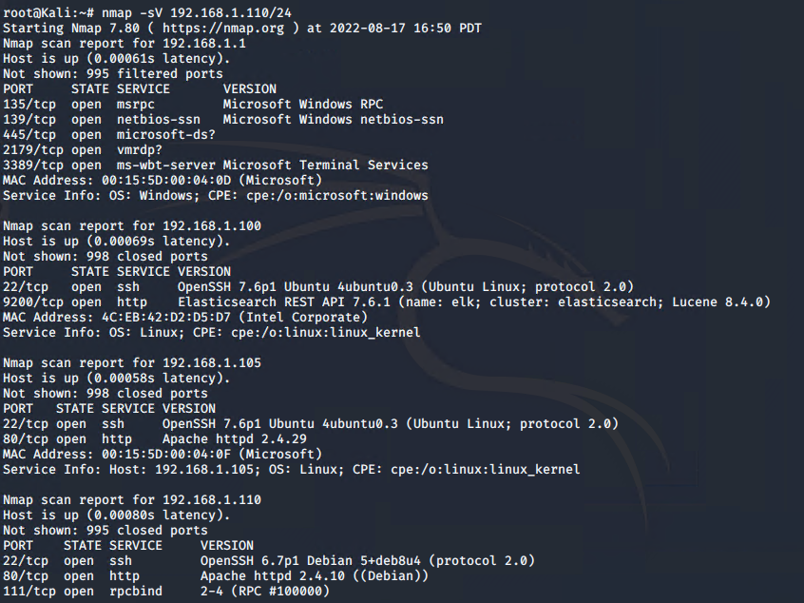
Exploitation: Nmap Scan
Command used: nmap -sV 192.168.1.110/24.
Discovered port 22 was open for SSH on the target machine

Slide 8
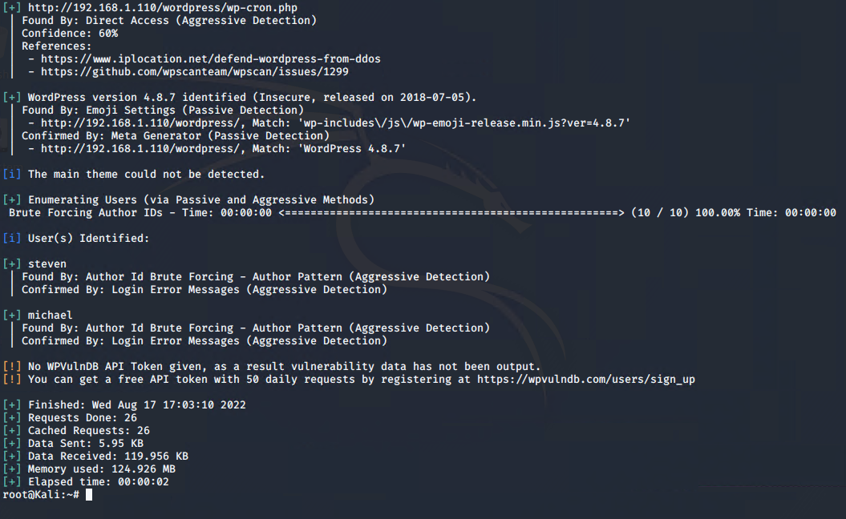
Exploitation: Sensitive Data Exposure (enumerate WordPress site)
Command used: wpscan --url 192.168.1.110/wordpress --enumerate u
We were able to identify users steven and michael

Slide 9
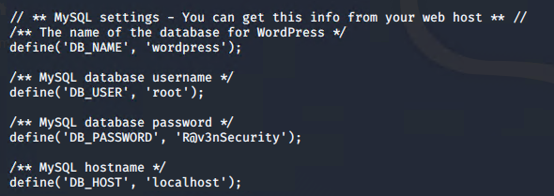
Exploitation: Weak Password Rules/Sensitive Data Exposure cont…
Through manual brute force, we were able to guess Michael’s password (password: michael)
Once in his system, we discovered credentials to access the MySQL database, and eventually obtain the users hashes.

Slide 10
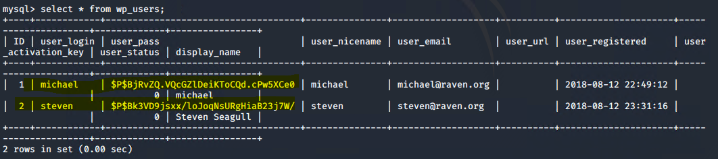
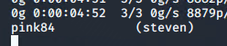
Exploitation: Weak Password Rules/Sensitive Data Exposure cont…
Once in the MySQL Database, we dumped the user hashes in a “wp_hashes.txt” file, and used the John The Ripper tool to crack Steven’s password (password: pink84).
Command used: “john wp_hashes.txt”

Slide 11
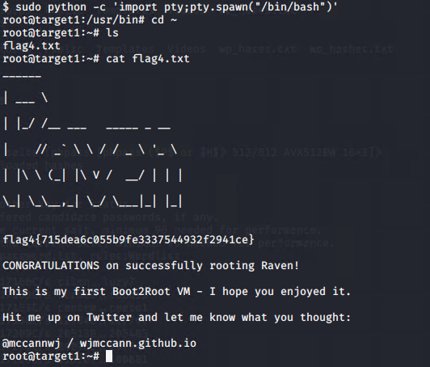
Exploitation: Unsecured Root Privileges
After cracking Steven’s hash, we ssh’d into the system using his password and used the following command to escalate to root privileges
command: sudo python -c ‘import pty;pty.spawn(“/bin/bash”)’

Slide 12
Avoiding Detection
12

Slide 13
Stealth Exploitation of Nmap Scan
Monitoring Overview
HTTP Request alerts can detect this exploit
The metric measured is the number of HTTP Requests sent to the system
The alert we set up fires above 400 for the last 5 minutes
Mitigating Detection
We can modify our original nmap command to conduct a “stealth” or “SYN” scan with the following command: nmap -sVS 192.168.1.110
Alternatives to nmap include zmap, which is significantly faster than nmap; hping, which has more capabilities than nmap, such as firewall testing and advanced port scans; NetScan, which provides a GUI for scanning networks

Slide 14
Stealth Exploitation of Wordpress Site Enumeration
Monitoring Overview
Which alerts detect this exploit?
WHEN count() GROUPED OVER top 5 ‘http.response.status_code’ IS ABOVE 400 FOR THE LAST 5 minutes
Which metrics do they measure?
http.response.status_code
Which thresholds do they fire at?
Above 400
Mitigating Detection
Are there alternative exploits that may perform better?
The gobuster tool could be used as an alternative to brute force the “hidden” directories and files on the web site.

Slide 15
Stealth Exploitation of Brute Force Attack
Monitoring Overview
Which alerts detect this exploit?
A threshold alert designed to look for event code 4625 (An Account Failed to Logon).
Which metrics do they measure?
The event code 4625 alert would measure how many failed logins there and would run every 5 minutes
Which thresholds do they fire at?
The event code 4625 alert would fire if there are more than 500 failed logins in the 5 minute window.
Mitigating Detection
How can you execute the same exploit without triggering the alert?
One strategy that would avoid triggering the alerts designed to look for Brute Force attacks would be to set a limit to the number of attempts that is lower than what the alert is set for. This requires either knowing what the alert is set at, or doing some research to discover if there is a threshold that is commonly used to detect Brute Force attacks. Additionally an attacker could use a botnet to limit the number of requests coming from the same IP address.
Are there alternative exploits that may perform better?
There are stealthier options to obtaining a password than a Brute Force attack. Some of these options include Phishing and Social Engineering.

Slide 16
Stealth Exploitation of Unsecured Root Privileges
Monitoring Overview
Which alerts detect this exploit?
Sudo command monitoring
Which metrics do they measure?
we are able to monitor how many times a user has used a sudo command in order to become root.
Which thresholds do they fire at?
everytime a user uses a Sudo command (which should not be often) we can determine when a user is trying to escalate their privileges
Mitigating Detection
How can you execute the same exploit without triggering the alert? Since the alert will fire every time a sudo command is used we can use sudo only 1 time to not come across as suspicious
Are there alternative exploits that may perform better? we can set permissions to important files so that non sudo users have read,write & execute permissions. We can also set user ID to 0 which is root.

